Slide 1

Lexical Analysis
By, Dr. Saroja Devi H.

Slide 2
Overview
Role of lexical analyzer
Specification of tokens
Recognition of tokens
Lexical analyzer generator
Design of lexical analyzer generator

Slide 3
The role of lexical analyzer
token
Source
program
Lexical Analyzer
Parser
To semantic
analysis
getNextToken
Symbol
table

Slide 4
Why separate Lexical analysis and parsing
Simplicity of design
Improving compiler efficiency
Enhancing compiler portability

Slide 5
Tokens, Patterns and Lexemes
A token is a pair: a token name and an optional token value
A pattern is a description of the form that the lexemes of a token may take
A lexeme is a sequence of characters in the source program that matches the pattern for a token
Ex: the input 31 + 28 + 59 is transformed into the sequence
<num, 31> <+> <num, 28> <+> <num, 59>

Slide 6
Attributes for tokens
E = M * C ** 2
  <id, pointer to symbol table entry for E>
  <assign-op>
  <id, pointer to symbol table entry for M>
  <mult-op>
  <id, pointer to symbol table entry for C>
  <exp-op>
  <number, integer value 2>

Slide 7
Lexical errors
Some errors are out of power of lexical analyzer to recognize as fi is a valid lexeme.
  fi (a == f(x)) …
However it may be able to recognize errors like:
  d = 2r
Such errors are recognized when no pattern for tokens matches a character sequence.

Slide 8
Error recovery
Panic mode: successive characters are ignored until we reach to a well formed token
Delete one character from the remaining input
Insert a missing character into the remaining input
Replace a character by another character
Transpose two adjacent characters (For example, the string “ALISA” and “ALYSSA” are separated by an edit distance of 2 to transform 1 string to another)

Slide 9
Input Buffering
Because of the amount of time taken to process characters and the large number of characters that must be processed during the compilation of a large source program, specialized buffering techniques have been developed to reduce the amount of overhead required to process a single input character.
Sometimes lexical analyzer needs to look ahead some symbols to decide about the token to return.
Each buffer is of the same size N, and N is usually the size of a disk block, e.g., 4096 bytes. Using one system read command we can read N characters into a buffer.
A special character, represented by eof, marks the end of the source file.

Slide 10
Input buffering
In C language: we need to look after -, = or < to decide what token to return; here it could be start of two character operators like ==
There are many situations where we need to look at least one additional character ahead
We need to introduce a two buffer scheme, which are alternately reloaded, to handle large look aheads safely
E = M * C * * 2 eof
lexeme begin
forward

Slide 11
Pointers in Input Buffer
Two pointers to the input are maintained:
1. Pointer lexemeBegin, marks the beginning of the current lexeme, whose extent we are attempting to determine.
2. Pointer forward scans ahead until a pattern match is found.
Once the next lexeme is determined, forward is set to the character at its right end. Then, after the lexeme is recorded as an attribute value of a token returned to the parser, lexemeBegin is set to the character immediately after the lexeme just found.

Slide 12
Input Buffer: Sentinels
E = M eof * C * * 2 eof
eof
Switch (*forward++) {
case eof:
if (forward is at end of first buffer) {
reload second buffer;
forward = beginning of second buffer;
}
else if {forward is at end of second buffer) {
reload first buffer;
forward = beginning of first buffer;
}
else /* eof within a buffer marks the end of input */
terminate lexical analysis;
break;
cases for the other characters;
}
Sentinel is a special character, not part of the source program, and now it is eof.
One eof at the end of each buffer and one for entire end of input are needed.

Slide 13
Specification of tokens
In theory of compilation regular expressions are used to formalize the specification of tokens
Regular expressions are means for specifying regular languages
Example: here x* indicates zero or more strings matching x
    Id -> letter_(letter_ | digit)*
Each regular expression is a pattern specifying the form of strings
a+ : one or more strings matching string a
. Any character but newline a.*b

Slide 14
Regular definitions
d1 -> r1
d2 -> r2
…
dn -> rn
Example:
  letter_ -> A | B | … | Z | a | b | … | z | _
  digit -> 0 | 1 | … | 9
  id -> letter_ (letter_ | digit)*
Ref. table 3.8 in the text book.
_ denotes concatenation

Slide 15
Extensions
One or more instances: (r)+
Zero or one instances: r?
Character classes: [abc]
Example:
  letter _ -> [A-Za-z_]
  digit -> [0-9]
  id -> letter_(letter_|digit)*

Slide 16
Recognition of tokens
Starting point is the language grammar to understand the tokens:
  stmt -> if expr then stmt
  | if expr then stmt else stmt
  | Ɛ
  expr -> term relop term
  | term
  term -> id
  | number

Slide 17
Recognition of tokens (cont.)
The next step is to formalize the patterns:
  digit → [0-9] => 0|1| …|9
  digits → digit+
  number → digits optionalFraction optionalExponent (ex: 2340, 0.012, 2.32E4 or 1.89E-4)
  number → digits(. digits)? (E[+-]? digits)?
  letter → [A-Za-z_]
  id → letter (letter|digit)*
  if → if
  then → then
  else → else
  relop → < | > | <= | >= | = | < >
We also need to handle whitespaces:
  ws → (blank | tab | newline)+

Slide 18
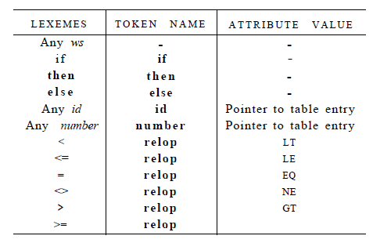

Tokens, patterns and attribute values
GE

Slide 19
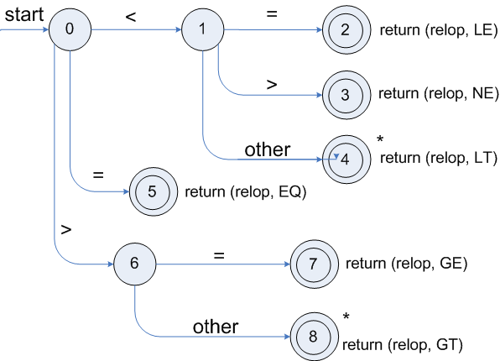
Transition diagrams
Note: Start state enters from nowhere.
Transition diagram for relop
Notations: Single circle: state,
Edge: transition, double circle: accepting state indicating detection of lexeme
* retract

Slide 20
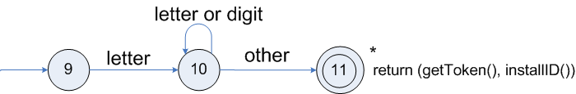

Transition diagrams (cont.)
Transition diagram for reserved words and identifiers
Hypothetical transition diagram for keyword then
Start
0
1
2
3
4
5

Slide 21
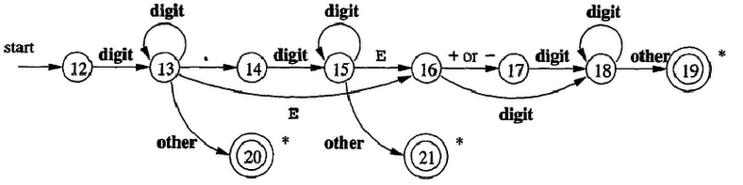
Transition diagrams (cont.)
Transition diagram for unsigned numbers
Number -> {digit}+(\.{digit}+)?(E[+-]?{digit}+)?

Slide 22
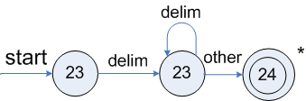
Transition diagrams (cont.)
Transition diagram for whitespace
Note: Start state enters from nowhere.

Slide 23
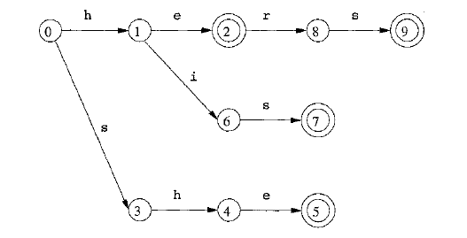
Other examples of transition diagrams
Finding he, she, his, hers

Slide 24
Design of a Lexical Analyser Generator: Lex generates architecture of a lexical analyser
Input buffer
lexeme
Lexeme begin
forward
Automaton simulator
Transition table
--------------Actions
Lex program
Lex compiler

Slide 25
Design of Lexer
A lex program is converted into a transition table and actions which are used by a finite automaton simulator
Components:
  A transition table for automaton
  Functions passed through Lex to the output
  Actions from the input program appearing as fragments of code to be invoked at the appropriate time

Slide 26
Lexical Analyzer Generator – Lex tool
Lex Source program
lex.l
Lexical Compiler
lex.yy.c
C
compiler
lex.yy.c
a.out/ a.exe
a.out/a.exe
Sequence of tokens
Input stream

Slide 27
Lex Tools
There is a family of software systems, including Lex,Flex Jflex, that are lexical analyzer generators.
The user specifies the patterns for tokens using an extended regular-expression notation.
Lex converts these expressions into a lexical analyzer that is essentially a deterministic finite automaton that recognizes any of the patterns.
Jflex (https://jflex.de/) is a lexer/scanner generator for Java.

Slide 28
Structure of Lex programs
declarations
%%
translation rules
%%
auxiliary functions
Pattern {Action}

Slide 29
Hello Program in Lex
%{
#undef yywrap
#define yywrap() 1
%}
%%
[\n] {
printf("Hello World \n");
}
%%
main()
{
yylex(); //calling the rules section
}
Declarations
Translation rules
Auxiliary functions

Slide 30
Example : LEX program fragment (for tokens in slide 18)
/* declarations
%{
/* definitions of manifest id, ops&constants
LT, LE, EQ, NE, GT, GE,
IF, THEN, ELSE, ID, NUMBER, RELOP */
%}
/* regular definitions
delim [ \t\n]
ws {delim}+
letter [A-Za-z]
digit [0-9]
id {letter}({letter}|{digit})*
number {digit}+(\.{digit}+)?(E[+-]?{digit}+)?
/* translation rules
%%
{ws} {/* no action and no return */}
if {return(IF);}
then {return(THEN);}
else {return(ELSE);}
{id} {yylval = (int) installID(); return(ID); }
{number} {yylval = (int) installNum(); return(NUMBER);}
“<” {yylval = LT; return(RELOP);}
“<=” {yylval = LE; return(RELOP);}
“=” {yylval = EQ; return(RELOP);}
“<>” {yylval = NE; return(RELOP);}
“>” {yylval = GT; return(RELOP);}
“>=” {yylval = GE; return(RELOP);}
/* Auxiliary functions
%%
Int installID() {/* funtion to install the lexeme, whose first character is pointed to by yytext, and whose length is yyleng, into the symbol table and return a pointer thereto */
}
Int installNum() { /* similar to installID, but puts numerical constants into a separate table */
}
Note: \c => character c literally

Slide 31
Miscellaneous concepts

Slide 32
Finite Automata
Regular expressions = specification
Finite automata = implementation
A finite automaton consists of
  An input alphabet Σ
  A set of states S
  A start state n
  A set of accepting states F ⊆ S
  A set of transitions state →^{input} state

Slide 33
Finite Automata
Transition
s₁ →ª s₂
Is read
  In state s₁ on input “a” go to state s₂
If end of input
  If in accepting state => accept, othewise => reject
If no transition possible => reject

Slide 34
Finite Automata State Graphs
A state
The start state
An accepting state
a
A transition

Slide 35
A Simple Example
A finite automaton that accepts only “1”
A finite automaton accepts a string if we can follow transitions labeled with the characters in the string from the start to some accepting state
1

Slide 36
Another Simple Example
A finite automaton accepting any number of 1’s followed by a single 0
Alphabet: {0,1}
Check that “1110” is accepted but “110…” is not
1
0

Slide 37
And Another Example
Alphabet {0,1}
What language does this recognize?
1
0
0
0
1
1

Slide 38
And Another Example
Alphabet still { 0, 1 }
The operation of the automaton is not completely defined by the input
  On input “11” the automaton could be in either state
1
1

Slide 39
Epsilon Moves
Another kind of transition: ε-moves
ε
A
B
Machine can move from state A to state B without reading input

Slide 40
Deterministic and Nondeterministic Automata
Deterministic Finite Automata (DFA)
  One transition per input per state
  No ε-moves
Nondeterministic Finite Automata (NFA)
  Can have multiple transitions for one input in a given state
  Can have ε-moves
Finite automata have finite memory
  Need only to encode the current state

Slide 41
Execution of Finite Automata
A DFA can take only one path through the state graph
  Completely determined by input
NFAs can choose
  Whether to make ε-moves
  Which of multiple transitions for a single input to take

Slide 42
Acceptance of NFAs
An NFA can get into multiple states
1
0
1
0
Input:
1
0
1
Rule: NFA accepts if it can get in a final state

Slide 43
NFA vs. DFA (1)
NFAs and DFAs recognize the same set of languages (regular languages)
DFAs are easier to implement
  There are no choices to consider

Slide 44
NFA vs. DFA (2)
For a given language the NFA can be simpler than the DFA
1
0
0
NFA
0
1
0
0
0
DFA
1
1
DFA can be exponentially larger than NFA

Slide 45
Regular Expressions to Finite Automata
High-level sketch
NFA
Regular
expressions
DFA
Lexical
Specification
Table-driven
Implementation of DFA

Slide 46
Regular Expressions to NFA (1)
For each kind of rexp, define an NFA
  Notation: NFA for rexp A
A
For ε
ε
For input a
a

Slide 47
Regular Expressions to NFA (2)
For AB
ε
A
B
For A | B
B
ε
ε
ε
ε
A

Slide 48
Regular Expressions to NFA (3)
For A*
ε
A
ε
ε

Slide 49
Example of RegExp -> NFA conversion
Consider the regular expression
  (1 | 0)*1
The NFA is
ε
1
ε
ε
C
E
A
B
1
ε
0
G
H
ε
I
J
ε
D
F
ε
ε

Slide 50
Next
NFA
Regular
expressions
DFA
Lexical
Specification
Table-driven
Implementation of DFA

Slide 51
NFA to DFA. The method
Simulate the NFA
Each state of resulting DFA
  = a non-empty subset of states of the NFA
Start state
  = the set of NFA states reachable through ε-moves from NFA start state
Add a transition S →ª S’ to DFA iff
  S’ is the set of NFA states reachable from the states in S after seeing the input a
    considering ε-moves as well

Slide 52
NFA -> DFA Example
ε
1
ε
ε
C
E
A
B
1
ε
0
G
H
ε
I
J
ε
D
F
ε
ε
0
0
FGABCDHI
0
1
ABCDHI
1
1
EJGABCDHI

Slide 53
NFA to DFA. Remark
An NFA may be in many states at any time
How many different states ?
If there are N states, the NFA must be in some subset of those N states
How many non-empty subsets are there?
  2^{N} - 1 = finitely many, but exponentially many

Slide 54
Implementation
A DFA can be implemented by a 2D table T
  One dimension is “states”
  Other dimension is “input symbols”
  For every transition S_{i} →ª S_{k} define T[i,a] = k
DFA “execution”
  If in state S_{i} and input a, read T[i,a] = k and skip to state S_{k}
  Very efficient

Slide 55
Table Implementation of a DFA
0
0
T
0
1
S
1
1
U
 | 0 | 1
S | T | U
T | T | U
U | T | U

Slide 56
Implementation (Cont.)
NFA -> DFA conversion is at the heart of tools such as flex or jflex
But, DFAs can be huge
In practice, flex-like tools trade off speed for space in the choice of NFA and DFA representations

